Slide 1
Context
Somass Chinook escapement target based on calculations using biostandards for fecundity at age:
 | Predicted Spawning Parameters
Age | %atAge | Fecundity | %Fem | PrespMort | Req Esc | Req Eggs | Predicted F by age | Proportion of eggs contributed
3 | 23% | 4000 | 7% | 0.8 | 5,756 | 1,289,438 | 403 | 3%
4 | 62% | 4400 | 50% | 0.8 | 15,513 | 27,302,818 | 7,756 | 70%
5 | 15% | 4800 | 75% | 0.8 | 3,614 | 10,407,745 | 2,710 | 27%
 |  |  |  |  | 24,883 | 39,000,000
More recent batch fecundity methods suggest values closer to 2500, 3700, and 4200, respectively.

Slide 2
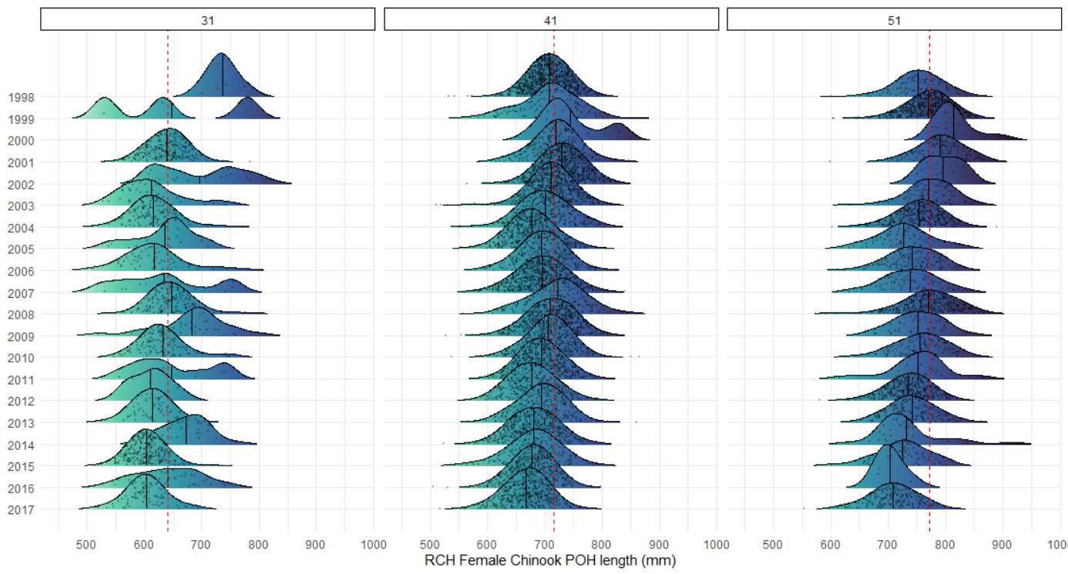
Size-at-age likely declining over time…
1998–2003 base period means

Slide 3
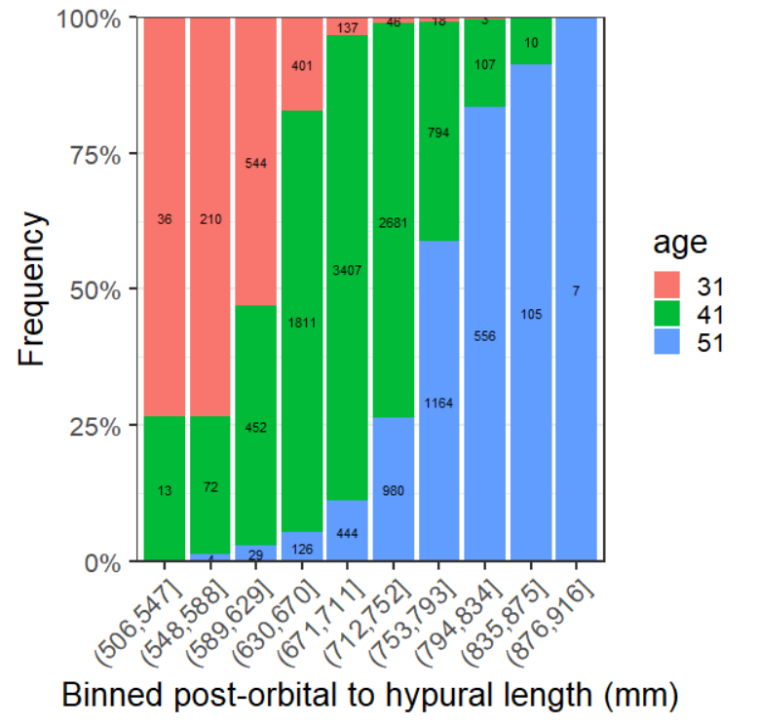
Target and realized sample sizes
Age comps by bin in historical data
2021 samples by bin and age
Bin | N | 31 | 41 | 51
(506,547] | 17 | 15 | 2 | 0
(548,588] | 16 | 10 | 6 | 0
(589,629] | 18 | 4 | 14 | 0
(630,670] | 19 | 1 | 18 | 0
(671,711] | 20 | 0 | 19 | 1
(712,752] | 16 | 1 | 13 | 2
(753,793] | 14 | 1 | 6 | 7
Total | 120 | 32 | 78 | 10

Slide 4
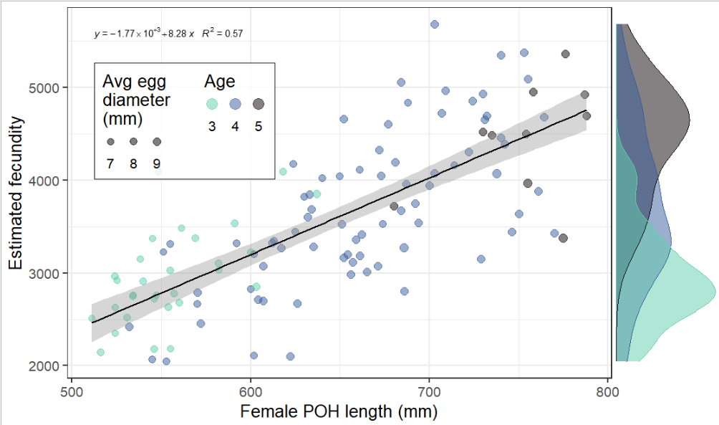
Results: relationship with length and age
4 510
3 526
2 879

Slide 5
If we then adjusted the calculations:
 | Spawning population parameters
Age | % at Age | Fecundity | % Fem | Prespawn Mortality | Required Escapement | Expected Egg Contribution
3 | 40% | 2,915 | 7% | 20% | 14,711 | 2,401,429
4 | 49% | 3,574 | 50% | 20% | 17,886 | 25,225,990
5 | 11% | 4,510 | 75% | 20% | 4,203 | 11,372,581
 |  |  |  | Totals: | 36,799 | 39,000,000
Notes:
Age composition based on 10-year historical averages
% Female at age based on historical biostandards

